Slide 1
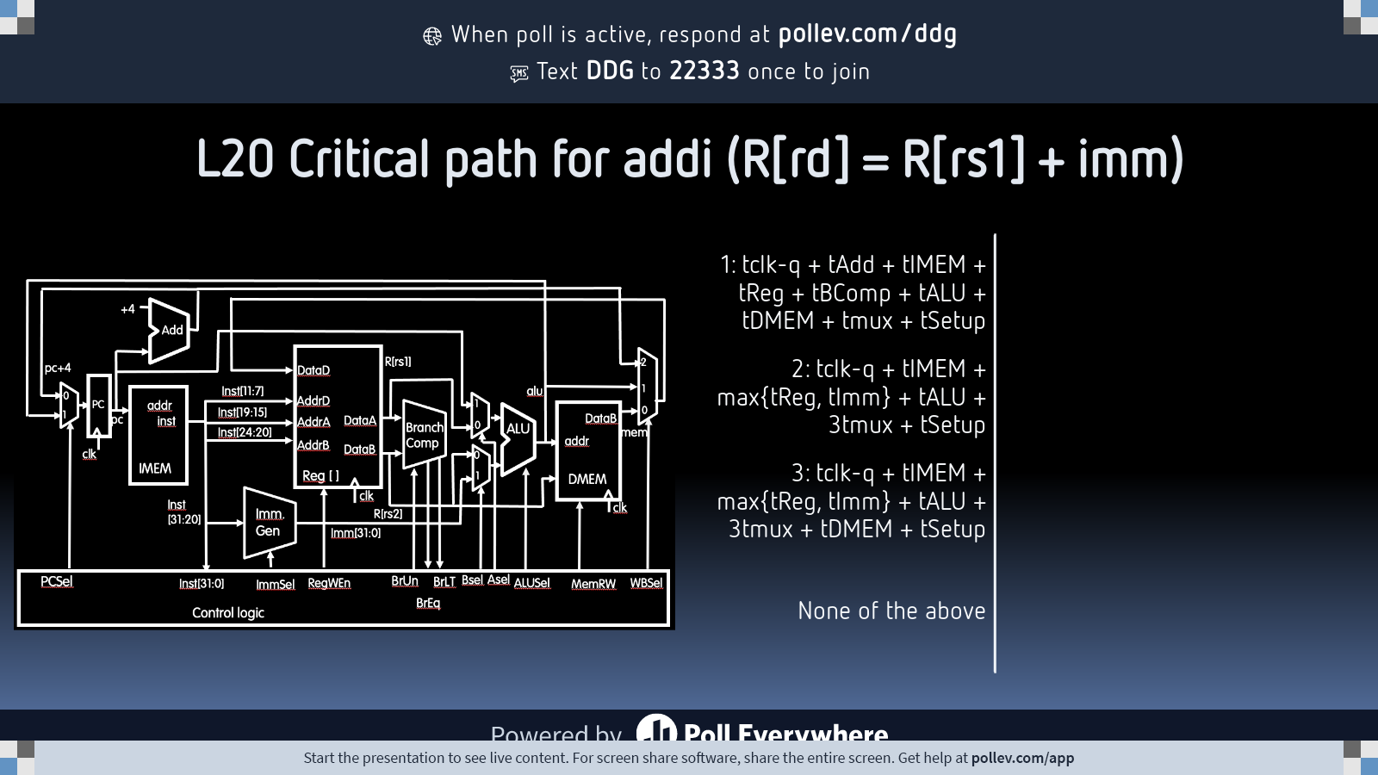
Notes:
Do not modify the notes in this section to avoid tampering with the Poll Everywhere activity. More info at polleverywhere.com/support L20 Critical path for addi (R[rd] = R[rs1] + imm)
https://www.polleverywhere.com/multiple_choice_polls/gLYsUx36lO6jCWyFlND9A?state=opened&flow=Default&onscreen=persist

Slide 2
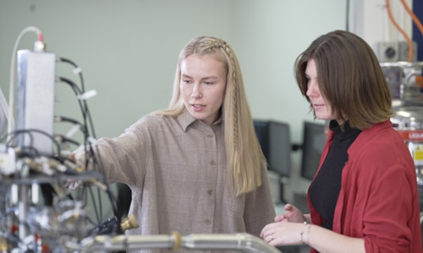
Quantum Computing Engineers Set New Standard in Silicon Chip Performance
Engineers at Australia's University of New South Wales, Sydney (UNSW Sydney) have coaxed quantum computing processors to hold data for up to two milliseconds, a more than 100-fold increase over previous benchmarks. This achievement extends the researchers' successful manipulation of millions of quantum bits (qubits) with a single antenna last year. … UNSW Sydney's Henry Yang called the SMART protocol "a potential path for full-scale quantum computers."
https://newsroom.unsw.edu.au/news/science-tech/longest-time-quantum-computing-engineers-set-new-standard-silicon-chip-performance

Slide 3
Pipelining

Slide 4


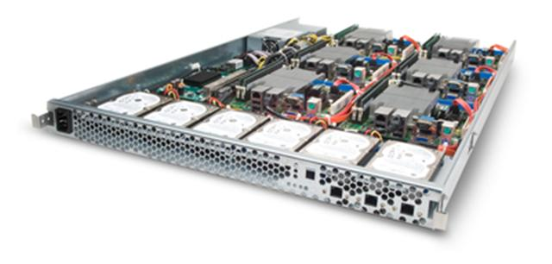
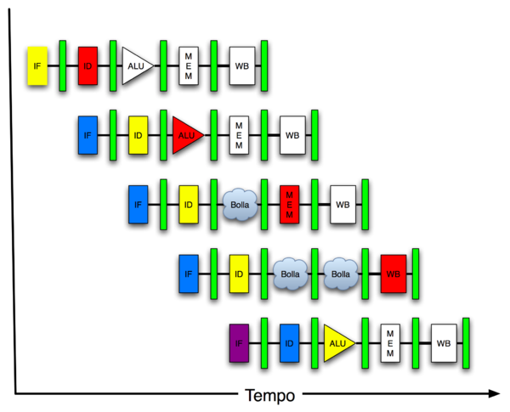
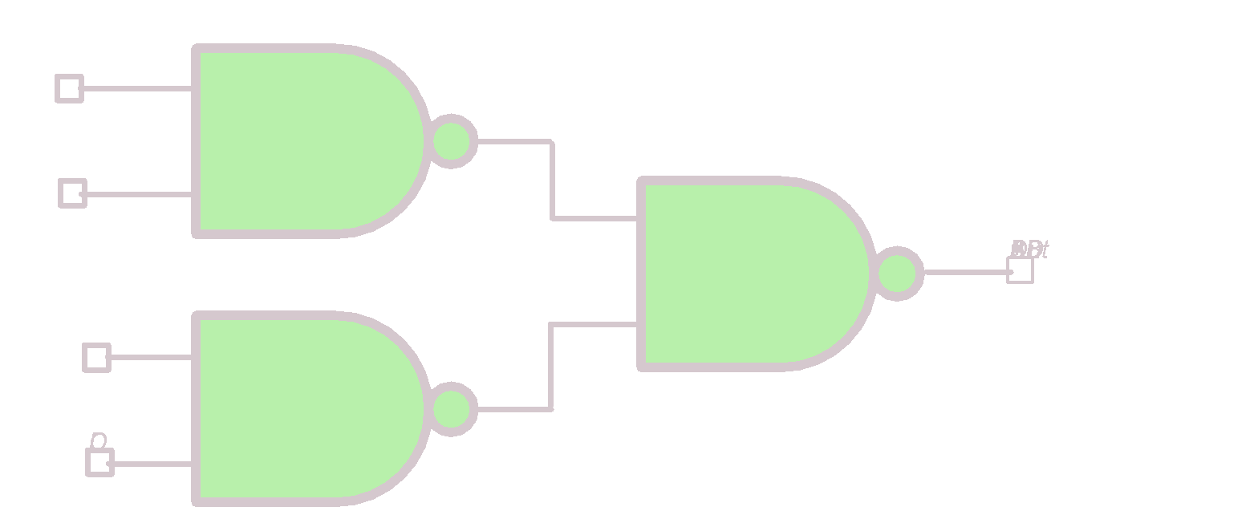
New-School Machine Structures
Software Hardware
Harness Parallelism &
Achieve High Performance
Parallel Requests
Assigned to computer
e.g., Search “Cats”
Parallel Threads
Assigned to core e.g., Lookup, Ads
Parallel Instructions
>1 instruction @ one time
e.g., 5 pipelined instructions
Parallel Data >1 data item @ one time
e.g., Add of 4 pairs of words
Hardware descriptions All gates work in parallel at same time
Smart Phone
Warehouse Scale Computer
Computer
Core
Core
Memory (Cache)
…
Input/Output
Exec. Unit(s)
Functional
Block(s)
A₀+B₀
A₁+B₁
Main Memory
Logic Gates

Slide 5
6 Great Ideas in Computer Architecture
Abstraction (Layers of Representation/Interpretation)
Moore’s Law
Principle of Locality/Memory Hierarchy
Parallelism
Performance Measurement & Improvement
Dependability via Redundancy

Slide 6
Instruction Timing
clock
PC
old
pc
pc+4
Instr. fetch
old
instruction
Instr. decode
old
register out
Execute
old
ALU result
Memory Access
old
memory data
t_{IF}
t_{ID}
t_{EX}
t_{MEM}
t_{WB}
IF | ID | EX | MEM | WB | Total
I-MEM | Reg Read | ALU | D-MEM | Reg W
200 ps | 100 ps | 200 ps | 200 ps | 100 ps | 800 ps

Slide 7
Instruction Timing
Instr | IF = 200ps | ID = 100ps | ALU = 200ps | MEM=200ps | WB = 100ps | Total
add | X | X | X |  | X | 600ps
beq | X | X | X |  |  | 500ps
jal | X | X | X |  |  | 500ps
lw | X | X | X | X | X | 800ps
sw | X | X | X | X |  | 700ps
Maximum clock frequency
f_{max} = 1/800ps = 1.25 GHz

Slide 8
Performance Measures
“Our” Single-cycle RISC-V CPU executes instrs at 1.25 GHz
1 instruction every 800 ps
Can we improve its performance?
What do we mean with this statement?
Not so obvious:
Quicker response time, so one job finishes faster?
More jobs per unit time (e.g. web server returning pages, spoken words recognized)?
Longer battery life?

Slide 9


Transportation Analogy
 | Sports Car | Bus
Passenger Capacity | 2 | 50
Travel Speed | 200 mph | 50 mph
Gas Mileage | 5 mpg | 2 mpg
50 Mile trip (assume they return instantaneously)
 | Sports Car | Bus
Travel Time | 15 min | 60 min
Time for 100 passengers | 750 min (50 2-person trips) | 120 min (2 50-person trips)
Gallons per passenger | 5 gallons | 0.5 gallons
Notes:
“Winner” depends on objectives

Slide 10
Computer Analogy
Transportation | Computer
Trip Time | Program execution time: e.g. time to update display
Time for 100 passengers | Throughput: e.g. number of server requests handled per hour
Gallons per passenger | Energy per task*: e.g. how many movies you can watch per battery charge or energy bill for datacenter
* Note: Power is not a good measure, since low-power CPU might run for a long time to complete one task consuming more energy than faster computer running at higher power for a shorter time

Slide 11
Processor Performance Iron Law

Slide 12
“Iron Law” of Processor Performance
Time = Instructions Cycles Time
Program Program * Instruction * Cycle
CPI = Cycles Per Instruction

Slide 13
Instructions per Program
Determined by
Task
Algorithm, e.g. O(N²) vs O(N)
Programming language
Compiler
Instruction Set Architecture (ISA)

Slide 14
(Average) Clock Cycles per Instruction (CPI)
Determined by
ISA
Processor implementation (or microarchitecture)
E.g. for “our” single-cycle RISC-V design, CPI = 1
Complex instructions (e.g. strcpy), CPI >> 1
Superscalar processors, CPI < 1 (next lectures)

Slide 15
Time per Cycle (1/Frequency)
Determined by
Processor microarchitecture (determines critical path through logic gates)
Technology (e.g. 5nm versus 28nm)
Power budget (lower voltages reduce transistor speed)

Slide 16
Speed Tradeoff Example
For some task (e.g. image compression) …
 | Processor A | Processor B
# Instructions | 1 Million | 1.5 Million
Average CPI | 2.5 | 1
Clock rate f | 2.5 GHz | 2 GHz
Execution time | 1 ms | 0.75 ms
Processor B is faster for this task, despite executing more instructions and having a slower clock rate!

Slide 17
Energy Efficiency

Slide 18
Where Does Energy Go in CMOS?
Symbol (INV)
Schematic
V
DD
V_{DD}
M
2
A
Out
A
Out
M
1
Charging capacitors
(CV²)
(70%)
Leakage
(30%)

Slide 19
Energy per Task
Energy = Instructions Energy
Program Program * Instruction
Energy α Instructions * C V²
Program Program
“Capacitance” depends on
technology,
processor features
e.g. # of cores
Supply voltage,
e.g. 1V
Want to reduce capacitance and voltage to reduce energy/task

Slide 20
Energy Tradeoff Example
“Next-generation” processor
C (Moore’s Law): -15 %
Supply voltage, Vsup: -15 %
Energy consumption: 0 - (1-0.853) = -39 %
Significantly improved energy efficiency thanks to
Moore’s Law AND
Reduced supply voltage

Slide 21
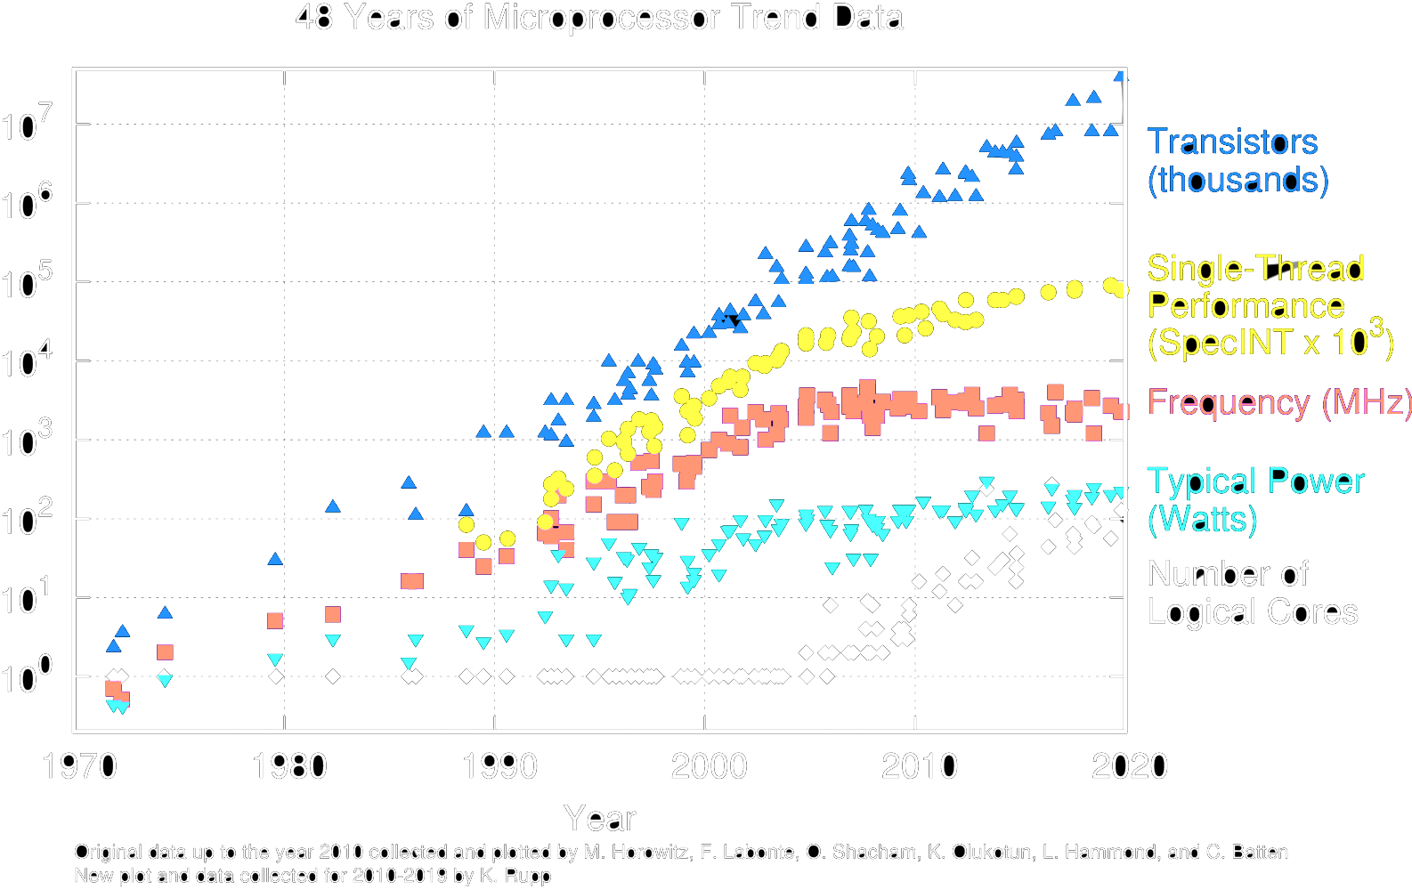
Performance/Power Trends

Slide 22
End of Dennard Scaling
In 1974, Robert Dennard observed that power density remained constant for a given area of silicon, while the dimension of the transistor shrank
In recent years, industry has not been able to reduce supply voltage much, as reducing it further would mean increasing “leakage power” where transistor switches don’t fully turn off (more like dimmer switch than on-off switch)
Also, size of transistors and hence capacitance, not shrinking as much as before between transistor generations
Need to go to 3D
Power becomes a growing concern – the “power wall”

Slide 23
Energy “Iron Law”
Energy efficiency (e.g., instructions/Joule) is key metric in all computing devices
For power-constrained systems (e.g., 20MW datacenter), need better energy efficiency to get more performance at same power
For energy-constrained systems (e.g., 1W phone), need better energy efficiency to prolong battery life
Performance = Power * Energy Efficiency
(Tasks/Second) (Joules/Second) (Tasks/Joule)

Slide 24
Introduction to Pipelining

Slide 25
Gotta Do Laundry
Avi, Bora, Caroline, Dan each have one load of clothes to wash, dry, fold, and put away
Washer takes 30 minutes
Dryer takes 30 minutes
“Folder” takes 30 minutes
“Stasher” takes 30 minutes to put clothes into drawers
A
B
C
D

Slide 26
Sequential Laundry
6 PM
7
8
9
10
11
12
1
2
T
a
s
k
O
r
d
e
r
30
30
30
30
30
30
30
30
30
30
30
30
30
30
30
30
Time
A
B
C
D
Sequential laundry takes 8 hours for 4 loads!

Slide 27
Pipelined Laundry
6 PM
7
8
9
10
T
a
s
k
O
r
d
e
r
30
30
30
30
30
30
30
30
A
Time
What happens sequentially?
What happens simultaneously?
B
C
D
Pipelined laundry takes 3.5 hours for 4 loads!

Slide 28
Sequential Laundry
6 PM
7
8
9
10
Pipelining doesn’t help latency of single task, it helps throughput of entire workload
Multiple tasks operating simultaneously using different resources
Potential speedup = Number of pipe stages
Time to “fill” pipeline and time to “drain” it reduces speedup: 2.3X v. 4X in this example
T
a
s
k
O
r
d
e
r
30
30
30
30
30
30
30
30
A
Time
B
C
D

Slide 29
Sequential Laundry
6 PM
7
8
9
10
Suppose: - new Washer takes 20 minutes - new Stasher takes 20 minutes.
How much faster is pipeline?
Pipeline rate limited by slowest pipeline stage
Unbalanced lengths of pipe stages reduce speedup
T
a
s
k
O
r
d
e
r
30
30
30
30
30
30
30
30
A
Time
B
C
D

Slide 30
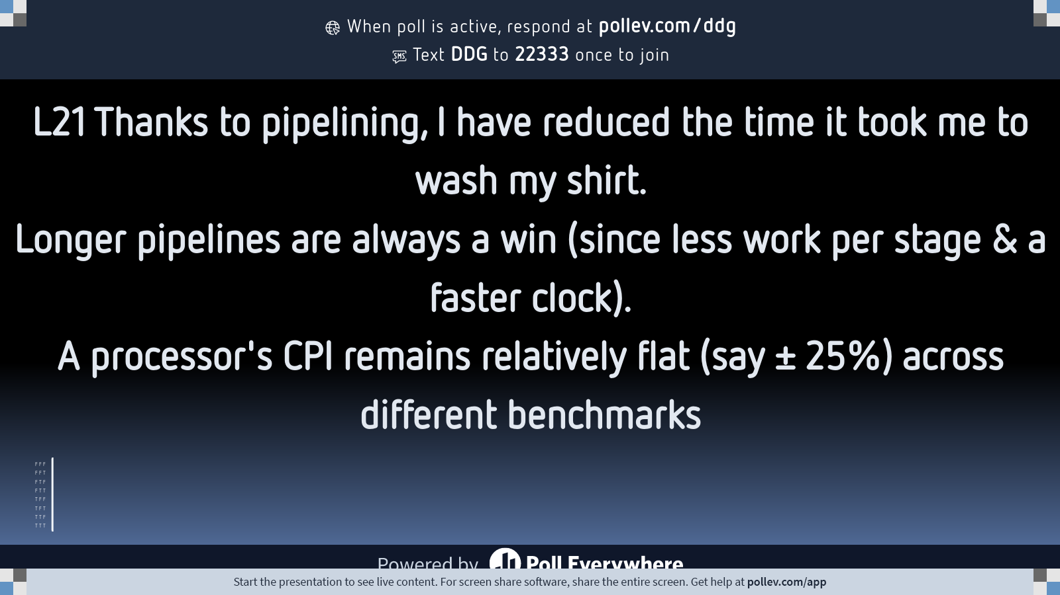
Notes:
Do not modify the notes in this section to avoid tampering with the Poll Everywhere activity. More info at polleverywhere.com/support L21 Thanks to pipelining, I have reduced the time it took me to wash my shirt.Longer pipelines are always a win (since less work per stage &amp; a faster clock).A processor's CPI remains relatively flat (say ± 25%) across different benchmarks
https://www.polleverywhere.com/multiple_choice_polls/xNjobWj4R5quC9yFOh2BG?state=opened&flow=Default&onscreen=persist

Slide 31
And in Conclusion, …
Instruction timing
Set by instruction complexity, architecture, technology
Pipelining increases clock frequency, “instructions per second”
But does not reduce time to complete instruction
Performance measures
Different measures depending on objective
Response time
Jobs / second
Energy per task

